Slide 1
EGI Data Hub and the Open Data Platform
Matthew Viljoen, Łukasz Dutka
EGI Engage JRA2.1 (WP4.1)

Slide 2
Before we start
Onedata
  software stack for distributed data management platform developed externally to EGI
EGI DataHub
  deployment of Onedata and ODP making existing large scale open data collection available in easy way for EGI Fedcloud users.
EGI Open Data Platform (ODP)
  extension to Onedata providing support for open data scenarios

Slide 3

For more information about release 3.0 go to http://beta.onedata.org

Slide 4









Onedata Spaces
User 1
User 2
User 3
Group
Is a kind of Virtual Directory with metadata
Is a kind of Virtual Directory with metadata
Each Space might be supported by many providers
P2P
P2P
ONEDATA Provider
ONEDATA Provider
ONEDATA Provider
ONEDATA Provider
Direct Access
Direct Access
Local Network Attached Storage
Storage
LustreFS
CephFS
Amazon S3
Private Resources
Active Repository Center 2
Active Repository Center 2
Private Resources

Slide 5




Components
FUSE Client
Oneclient
HTTP GUI
REST
Onezone
FUSE Client
FUSE Client
HTTP GUI
REST
FUSE Client

Slide 6




A possible environment
AWS USA
INFN Italy
Amazon S3
NFS Server
VM nfs
Docker Oneclient
Docker
Docker Onezone
Docker
Docker Oneclient
DNS: p-aws-useast
VM onezone
VM oneprovider
VM oneclient
UPV Spain
Laptop OSX
Docker Oneclient
Docker
Docker Oneclient
SAMBA
Export
POSIX
Volume
boot2docker
VM: demo-onedata-upv-provider

Slide 7
Oneworld

Slide 8
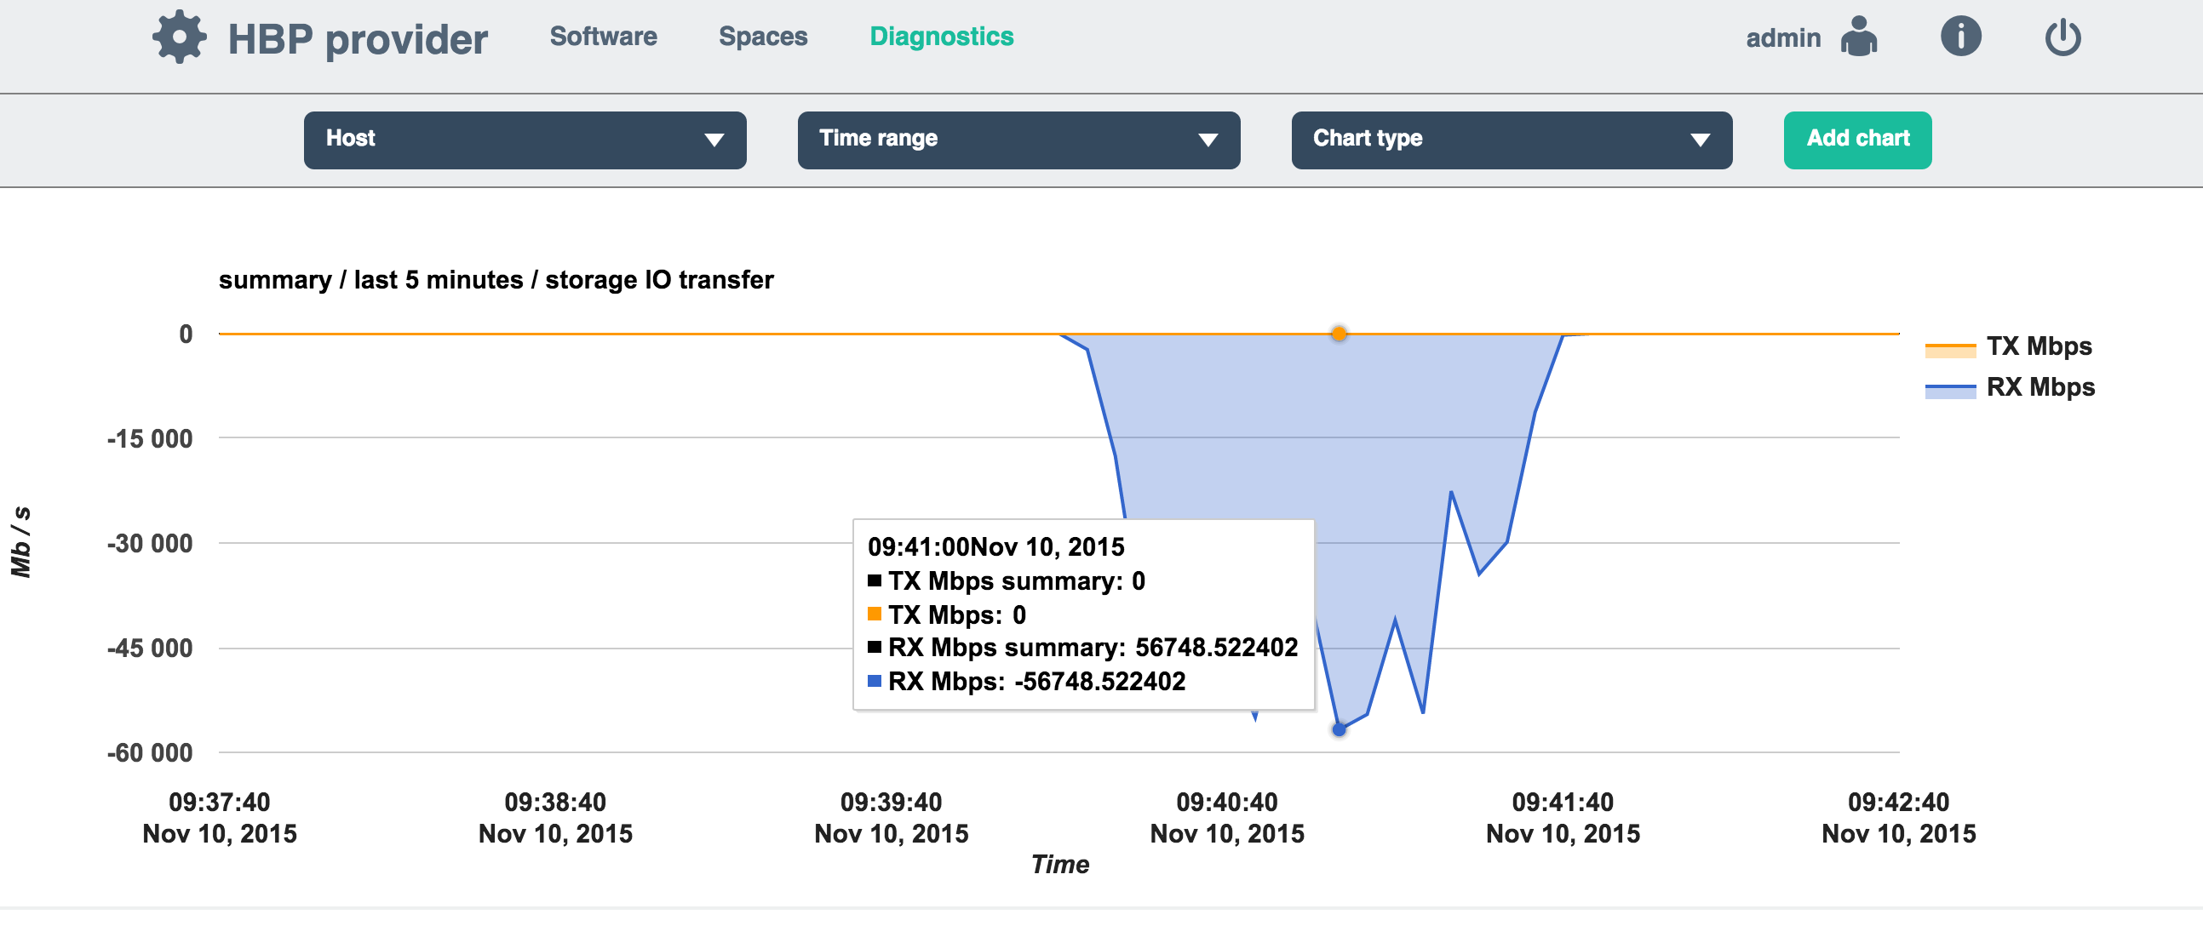
High Performance Access
55 Gbit/s = 7 GB/s
on a single
node

Slide 9
Onedata Summary
Distributed and decentralized repositories
Pluggable architecture for various data types
Flexible data sharing and access control
Concept of “projects” called “data spaces”
Multiple interfaces for data access: CDMI, POSIX, REST, WebGUI, command line
High-throughput clients for larger data centres
Metadata management
Data migration and replication
Fine-grain ACL

Slide 10
EGI Open Data Platform

Slide 11
Main Objectives
lower barrier for EGI users in publishing their data as open
simplify access and processing of open data for EGI users
integrate and virtualize existing EGI data storage solutions
persistent data identification (DOI)
optimize access to open data provided by both external and internal EGI open data providers
provide means for tracking open data usage statistics
data as a service solution

Slide 12
Community requirements collection
REQ1. Publication of open research data based on policies
REQ2. Make large data sets available without transferring them completely
REQ3. Enabling complex metadata queries
REQ4. Integration of the open data access data management with community portals
REQ5. Data identification, linking and citation
REQ6. Enabling sharing of data between researchers under certain conditions
REQ7. Sharing and accessing data across federations
REQ8. Long term data preservation
REQ9. Data provenance
EGI Community Forum, 2015 Bari

Slide 13
Opendata Platfom Analogies
The major functionalities are based on concepts:
  Git fork
  Git watch
  Dropbox share
  Docker pull and push
However:
  we are working with data sets
  we are working with entirely decentralized environment of loosely coupled data providers
  data collections might be huge

Slide 14








Open Data Platform Interactions
Public Services
For Data Discovery
2: opendata publish
collection Data-set-1.1
-> DOI.1
3: discover data
3: discover data
-> DOI.1
-> DOI.1
Snapshot
Data-set-1.1
4: Visit Collection
Web Page (HTTP)
5: opendata mount remote
DOI.1 /localdir/
Data-set-1.1
Mounted to
/localdir/
1: opendata create
snapshot Data-set-1
6: opendata fork DOI.1
Lazy Replication
Data–set-1
Cloned
Data-set-1.1
Private Resources
Private Resources

Slide 15

Publish
Data as Open
Register Metadata
Register Metadata
Heterogenous
storage
Open Data Platform
Access To
Open Data
Access To
Open Data
Register Metadata
Discover
Open Data
Metadata
Comp. Resources Grid / Cloud
Migrate Data
When Neccessary
EGI Resource Center
Non-EGI Open Data Provider
Access To
Open Data
Open Data Persistent Repository
Migrate Data
When Neccessary
Discover
Open Data
Publish
Data as Open
Heterogenous
storage
Open Data Platform
Community X Indexing Service
Access To
Open Data
Register Metadata
Discover
Open Data
Comp. Resources Grid / Cloud
Metadata
Register
Discovered Data
EGI Resource Center
User

Slide 16
Open Data Platform interfaces
GUI
REST
CDMI
POSIX
OAI-PMH
HTTP
Web based.
Easy data management and sharing, access control
Publication of data items and collections
Advanced data and collection mgmt.
API for integration with community tools and portals
Standard data management operations
Advanced metadata queries
Integration with future data management applications
Enable direct mounting of spaces in the local filesystem without full data transfer
OAI Data Provider interface
Dublin Core metadata by default
More complex metadata can be registered in ODP directly
Direct download of open data from URL’s
Open data collection presentation
Open Data Platform
EGI Community Forum, 2015 Bari

Slide 17


Open Data Platform interactions
DOI Registrar (e.g. DataCite)
Community Portal
EGI User 1 (VO x)
Anonymous
User 1
EGI User 2
(Onedata space)
Anonymous
User 2
REST
Web GUI
POSIX
HTTP
OAI-PMH
CDMI
REST
Space Manager
Space Manager
Open Data Manager
Metadata Registry
OAI-PMH Data
Provider
Authentication and Authorization
Long Term Retention
Open Data Platform
Generatore AIP package for abc
EGI Site 1
EGI Site 2
EGI Site 3
Cloud storage
EUDAT

Slide 18
Under implementation
Open Publish ACLs
Space snapshots
“Light” forking feature
Generation of DOI
Implementation of OAI-PMH interfaces
Generation of long term retention packages (e.g. AIP)

Slide 19
EGI DataHub

Slide 20
EGI DataHub Role
Unified access to reference scientific data of public interest.
Host experimental or temporary scientific data and enable easy access to it by appropriate scientific applications.
Distributed platform for managing replicas of publicly available data collection available on EGI Infrastructure
Data here could mean datasets ­ a collection of data/files/filesets at a level of granularity considered useful to user communities.

Slide 21
Current Landscape
Public Data
Repository X
Public Data
Repository Y
Community Specific Data Discovery
Community Specific Data Discovery
AWS
S3
Existing Replica
Public Clouds
Private
Comp. Cloud
LUSTRE
S3
Ceph
NFS
EGI Resource Centres
EGI Resource Centres
Private Resources

Slide 22
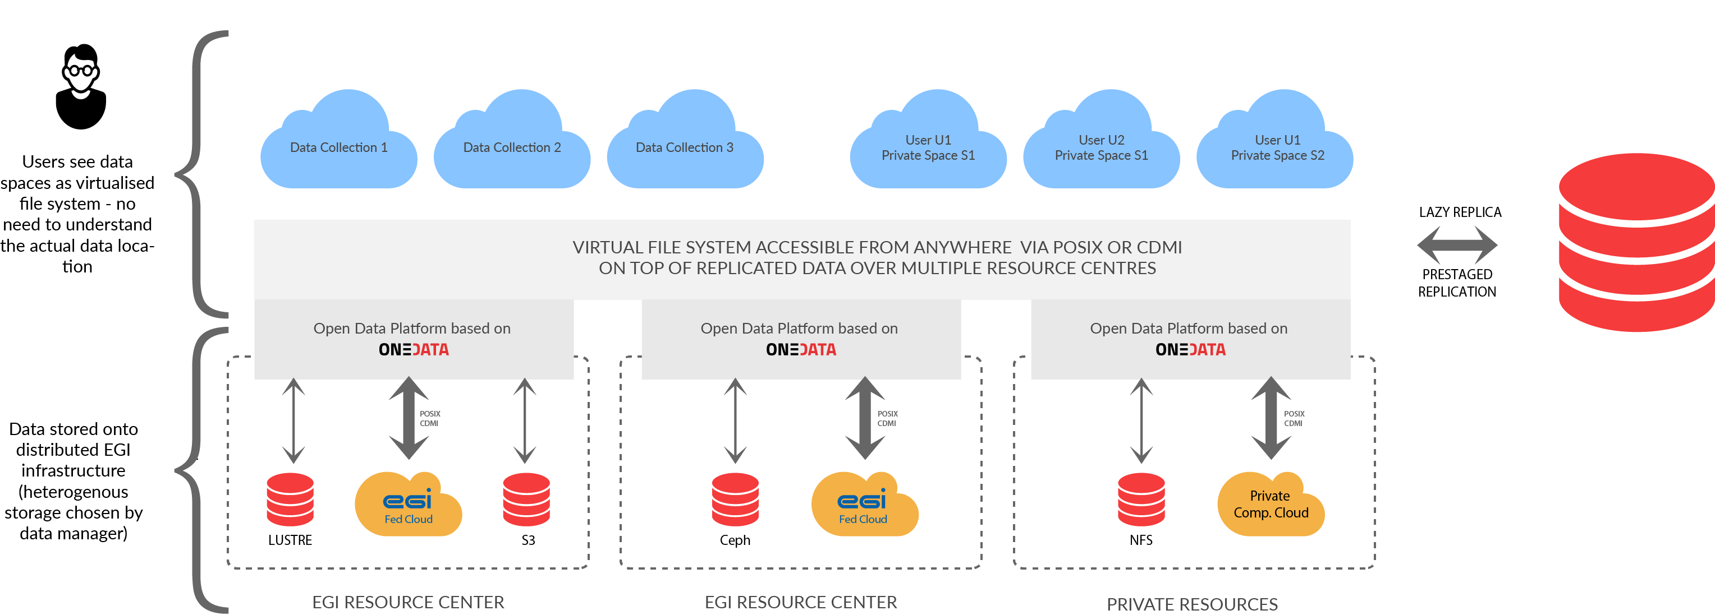
The Landscape Changed by DataHub

Slide 23
DataHub Processes / Use Cases
EGI.eu collects interest for data collections that should be available in DataHub
EGI.eu finds Resource Centres willing to support replica of the collections
EGI.eu and Data Providers negotiate technical means of replication data collection to the Resource Centers
Data Providers inform users about EGI replicas
Data Collections discoverable in AppDB
Users “link” collections of their interest in personal data hub space trough Data Providers JS widget or AppDB
Users can access data collections via POSIX virtual file system or HTTP requests on all EGI resources
Users can share their private resources in the same way as public collections

Slide 24
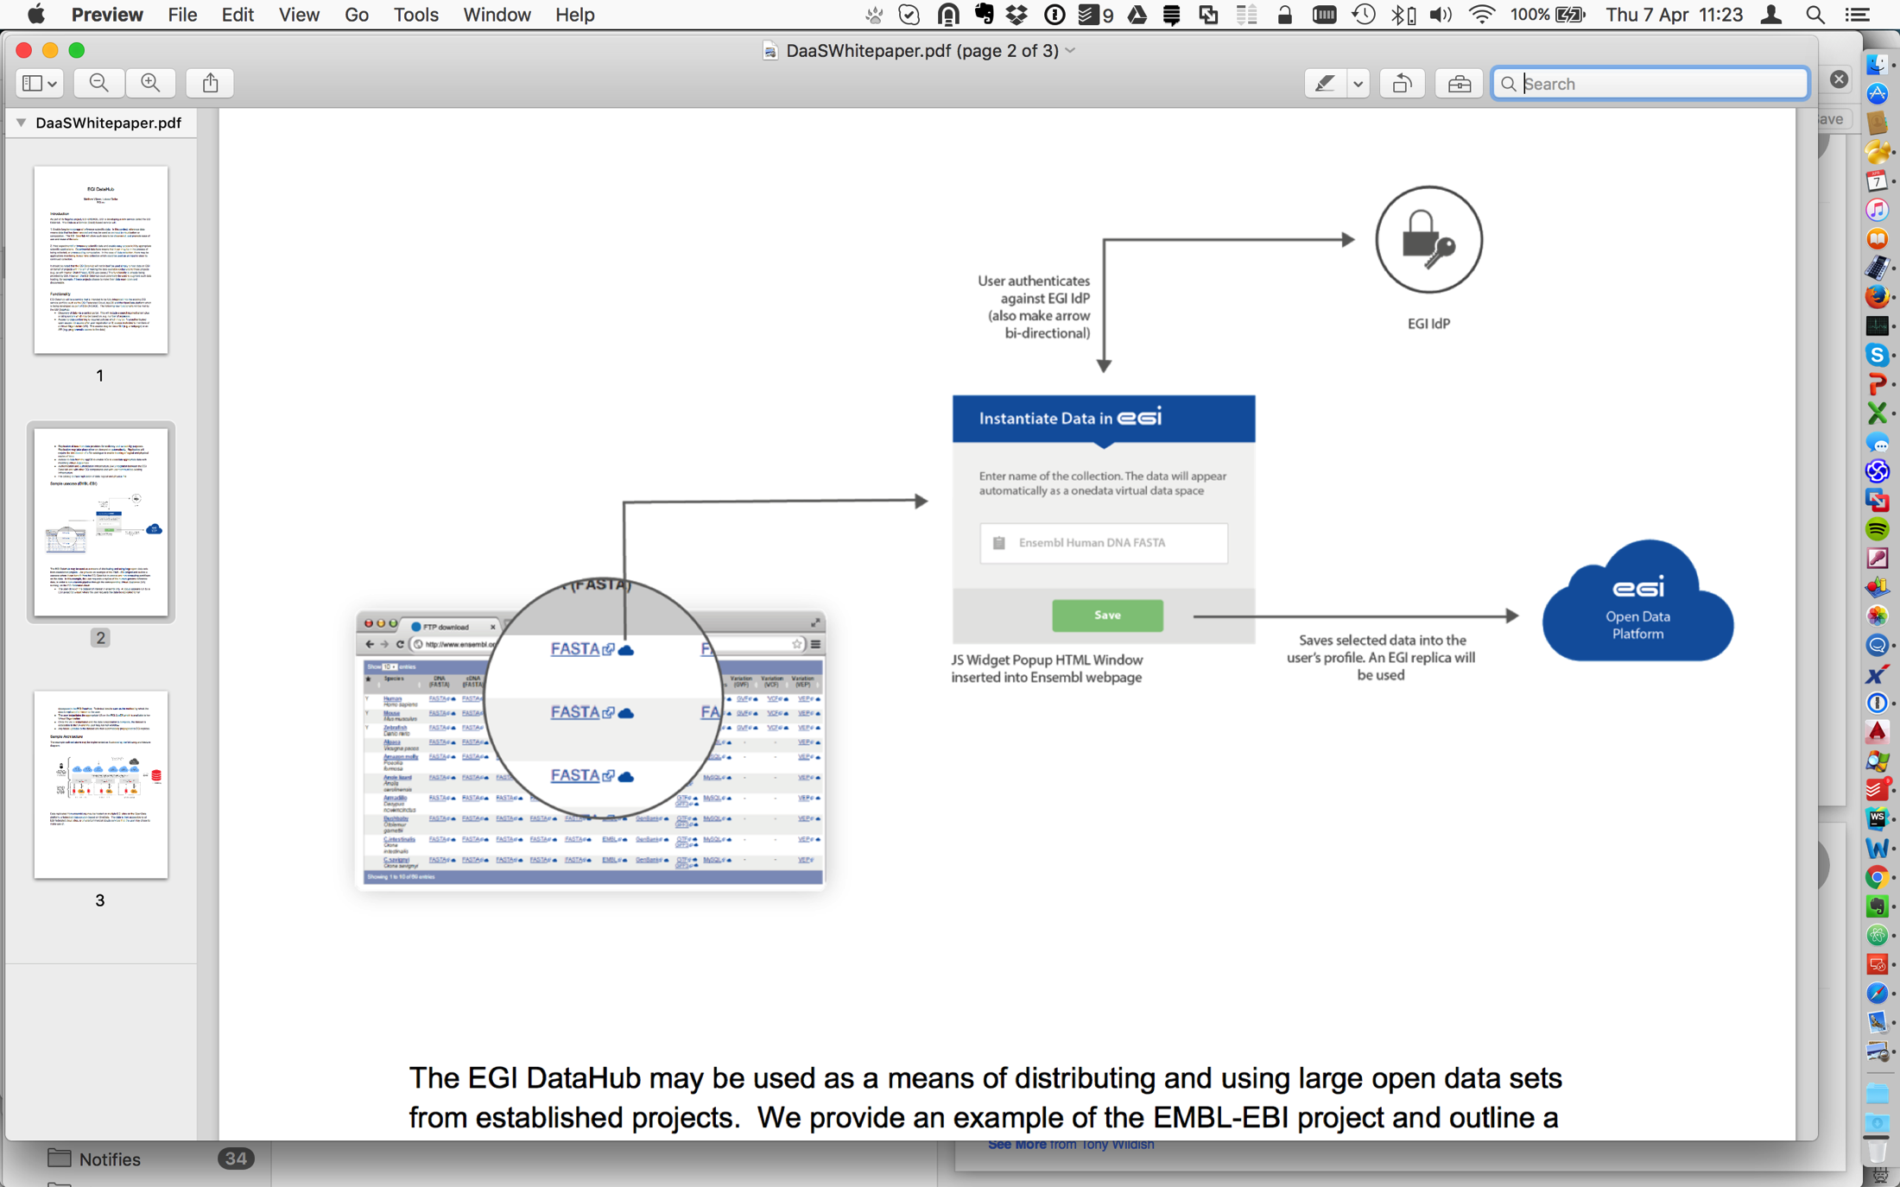
Concept of Data Widgets

Slide 25
Data Discovery Issues
DataHub is not to replace community specific data discovery mechanism
DataHub provides basic interface for access to metadata
DataHub provides interface for building added value discovery services running on top of EGI Cloud
Ideally DataHub should be integrated with existing discovery webpages using JS widget to enable direct “linking” selected data to make it available on cloud resources
Data Collections available replicated to DataHub should be registered in EGI AppDB, but AppDB is not intended to be major data discovery portal

Slide 26
Nearest Future Work Plan
Onedata
  New Features related to performance and WebGUI will be released before end of June
  New storage drivers and protocol handlers coming
  Release 3.0 to be tested by EGI Resource Centres
Open Data Platform
  Release the firsts version
  Select and integrate with early adopters
EGI DataHub
  Select data collections to be replicated to EGI
  Select Resource Centres ready to support the open collections
  Integrate data discovery services with EGI DataHub

